Slide 1
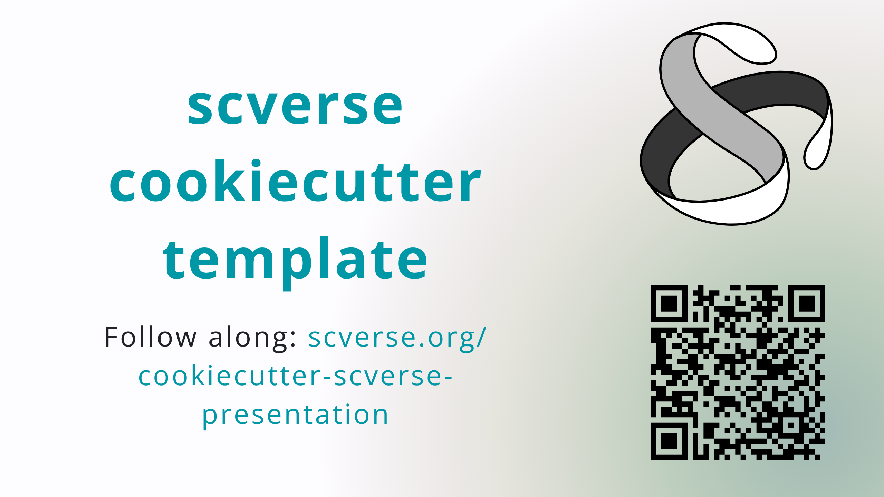
Notes:
Header link: important! Follow along if you’re quick, later interactive QR URL: https://api.qrserver.com/v1/create-qr-code/?format=svg&data=https://scverse.org/cookiecutter-scverse-presentation/

Slide 2
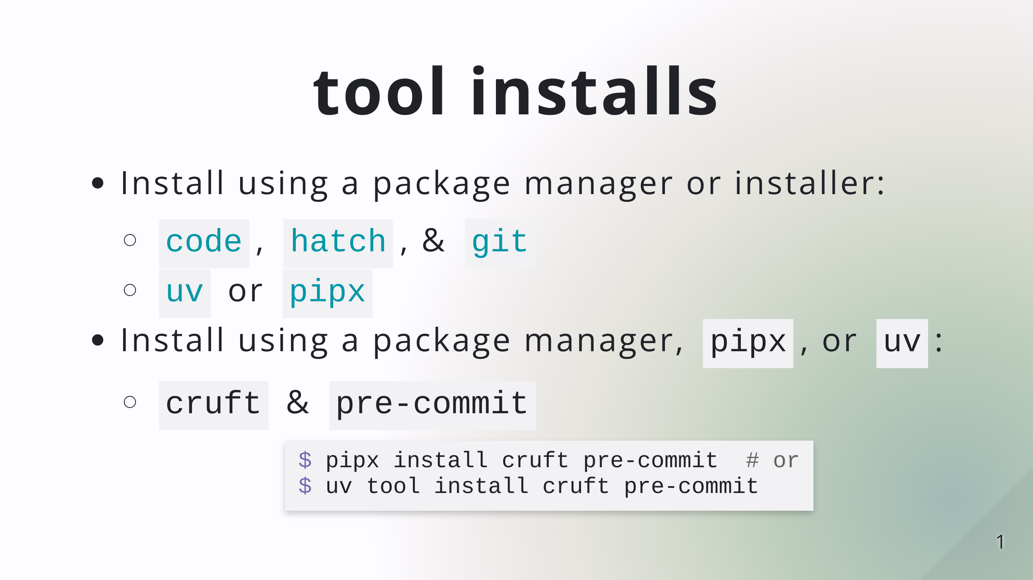

Slide 3
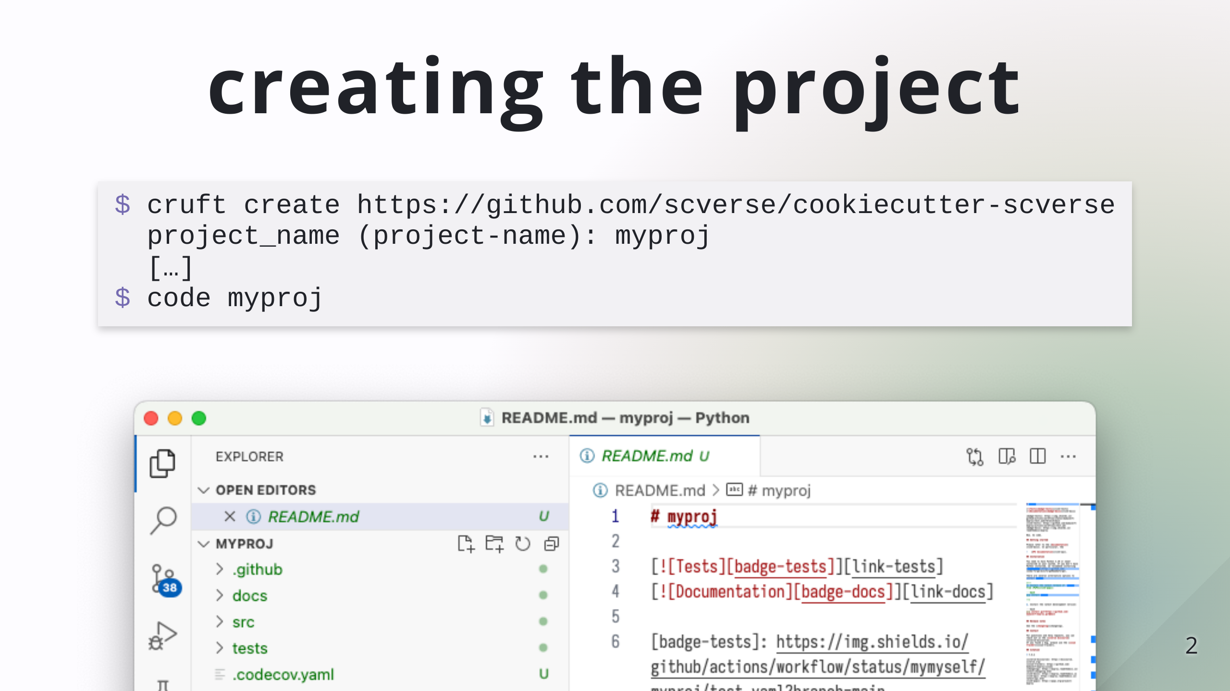

Slide 4
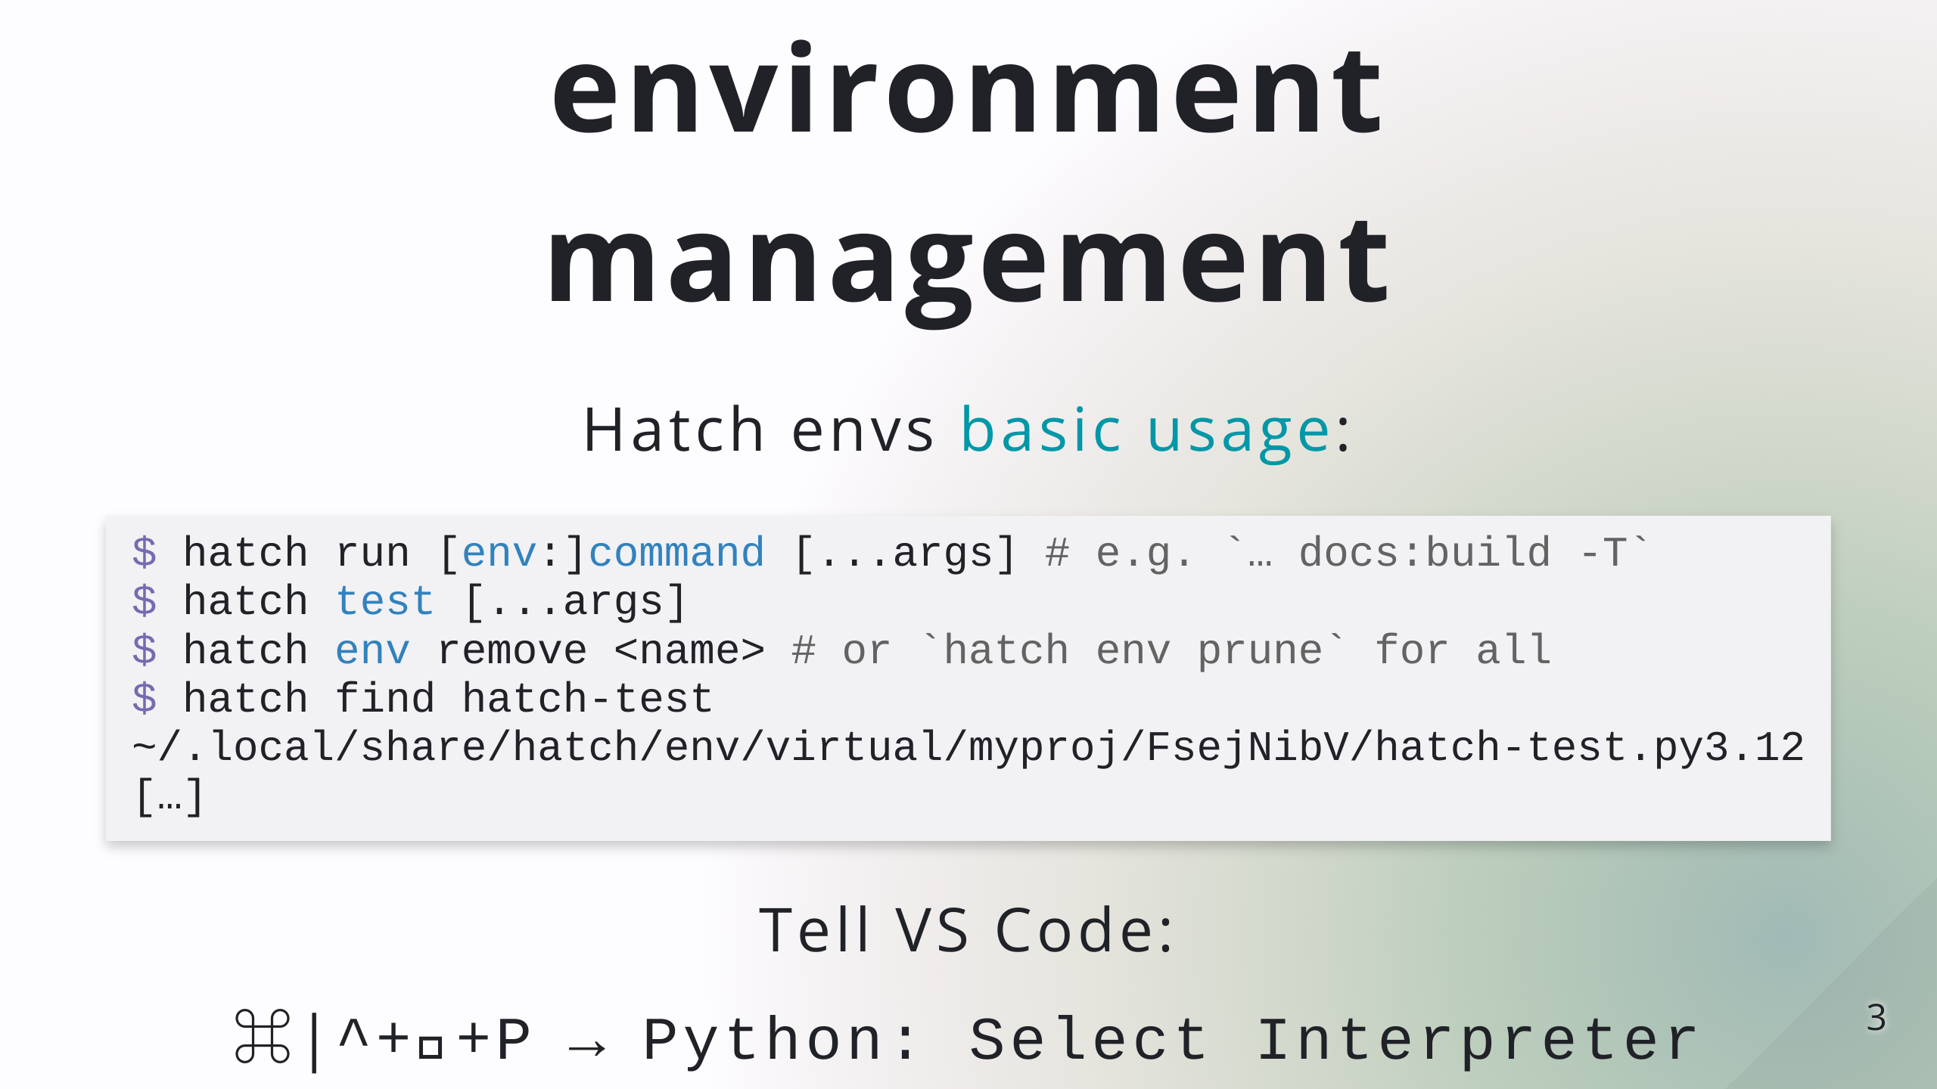

Slide 5
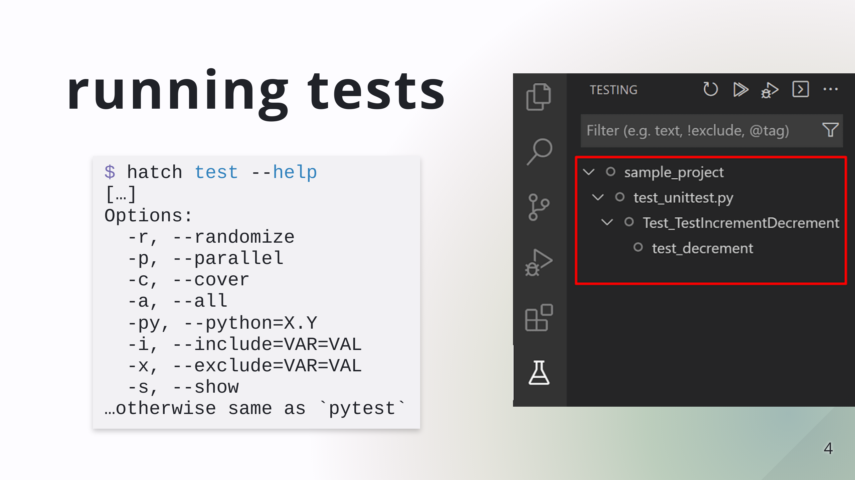

Slide 6
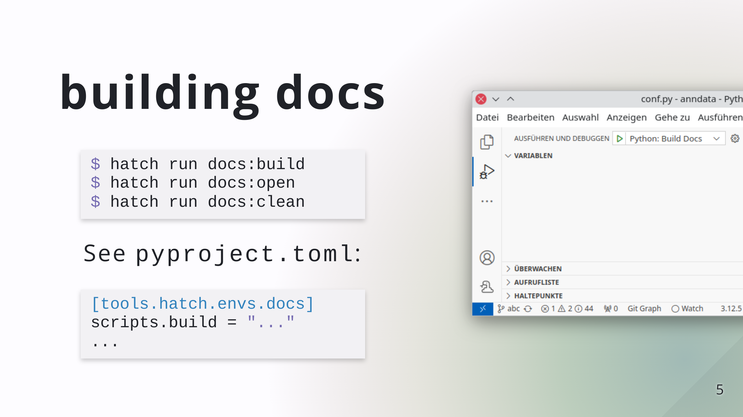

Slide 7
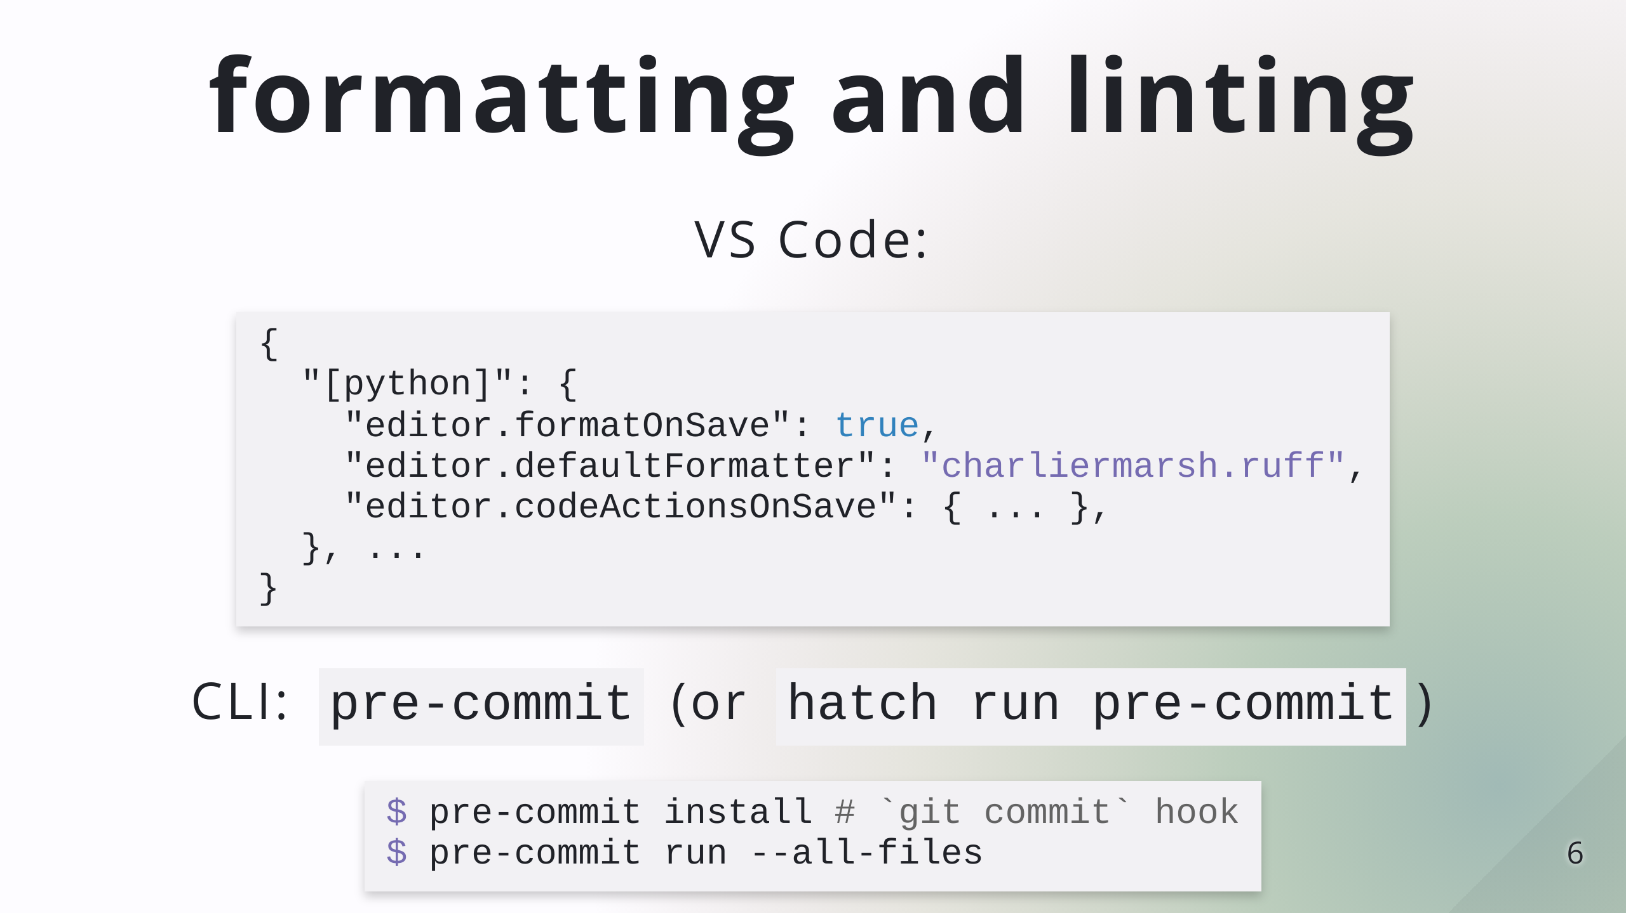
Notes:
Installing pre-commit globally is preferred

Slide 8
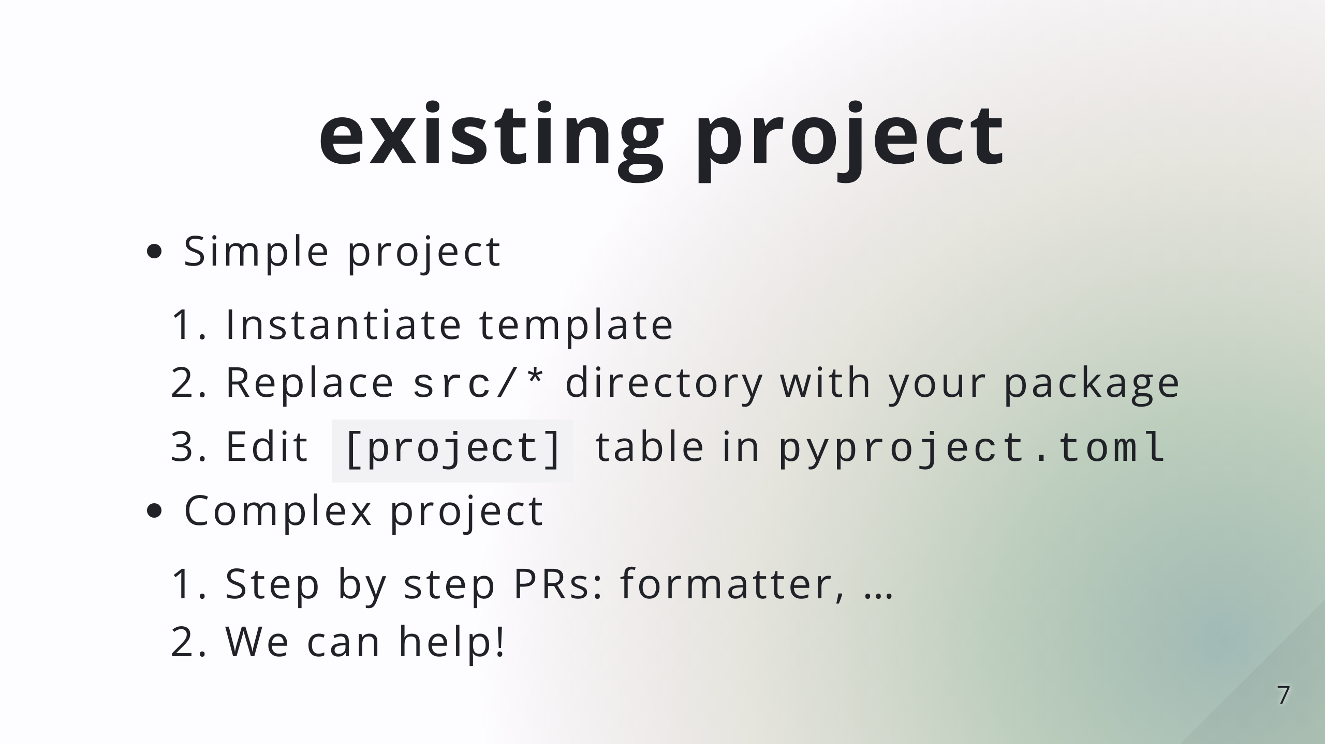
Notes:
simple: pure-python, one package

Slide 9


Slide 10
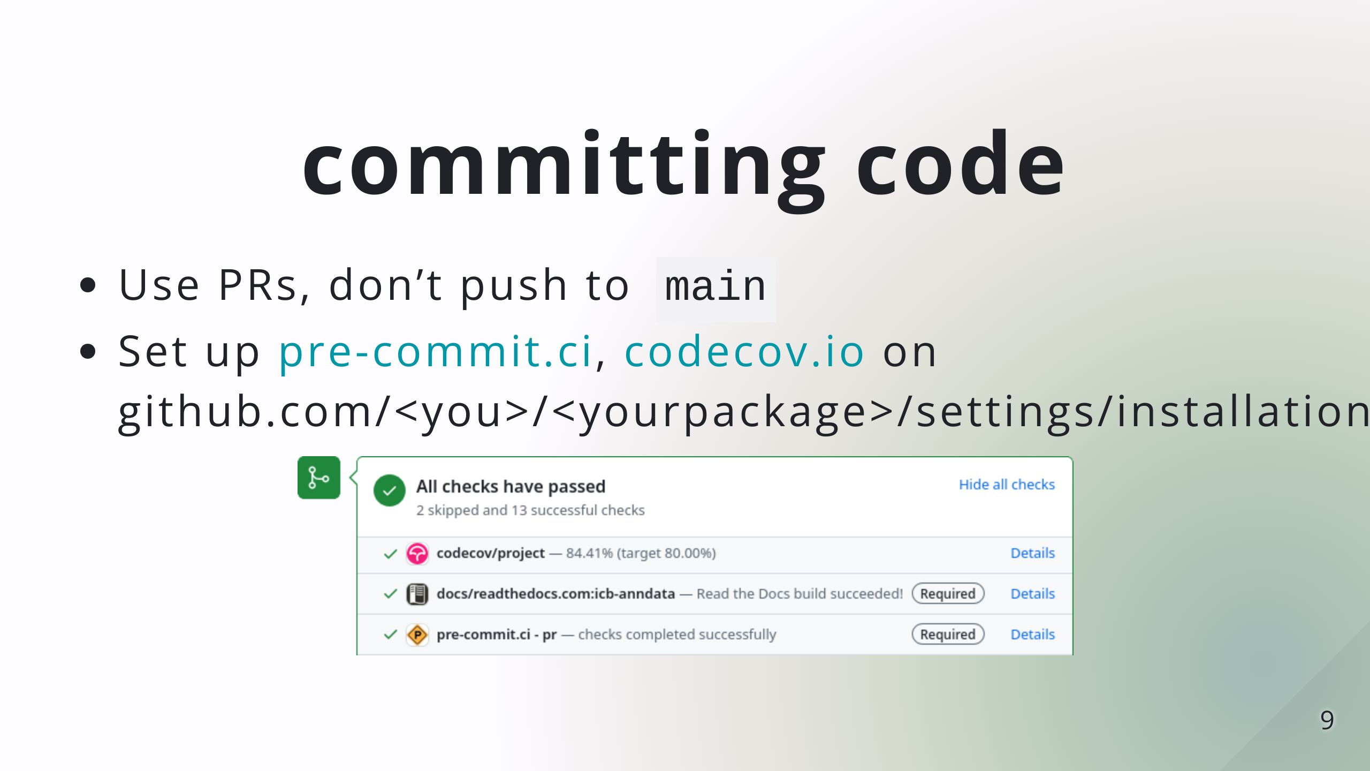
Notes:
No need to do this live, time should be mostly up here

Slide 11
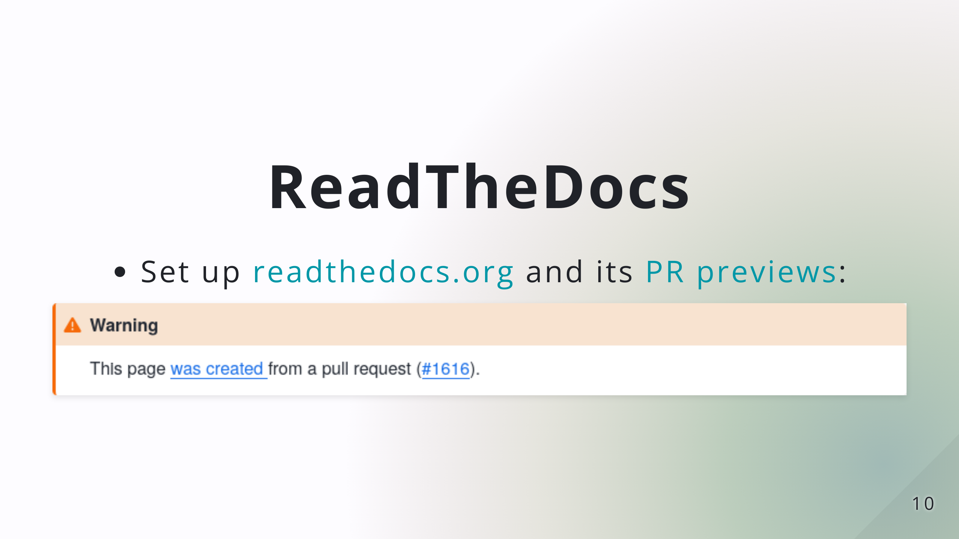

Slide 12


